Slide 1
Industrial Ergonomics on Cyclone Manufacturing
By: Tahsin Rezaul, Ryan Rajakulam, Muhammad Aras Naveed, Hosein Kobeissi

Slide 2
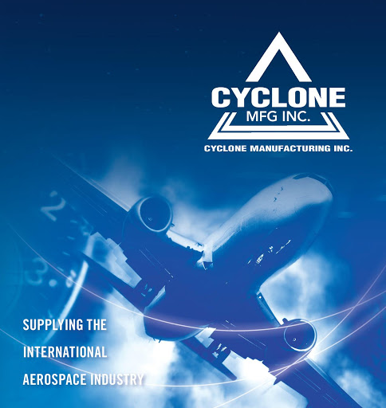
Human Factors Engineering Design at Cyclone MFG.
Aerospace Manufacturing company
6 branches with 500,000 sq ft of manufacturing space
200+ employees
Notes:
Cyclone Manufacturing is an aerospace company that works on assembling and machining aeroplane parts. The plant contains a linear like process that is followed throughout the facility as the parts travel from one procedure to the next but for this project we will be focusing on the MASKING PROCESS.

Slide 3
Step 1
Step 2
Masking Process
Step 3
Step 4
Mask Parts
Transport Masked Parts
Tape the boreings on parts where customer does not want paint
Push the racks with the parts to masker
Painter Paints
Transport Parts to Furnace
Paint the parts received according to customers needs
Open 300kg furnace door and place parts inside to dry
Notes:
Step 1 is masking the parts and placing them on boards
Step 2 is transporting the rack to the masker
Step 3 is painting the parts
And step 4 is transporting the racks into the furnace

Slide 4

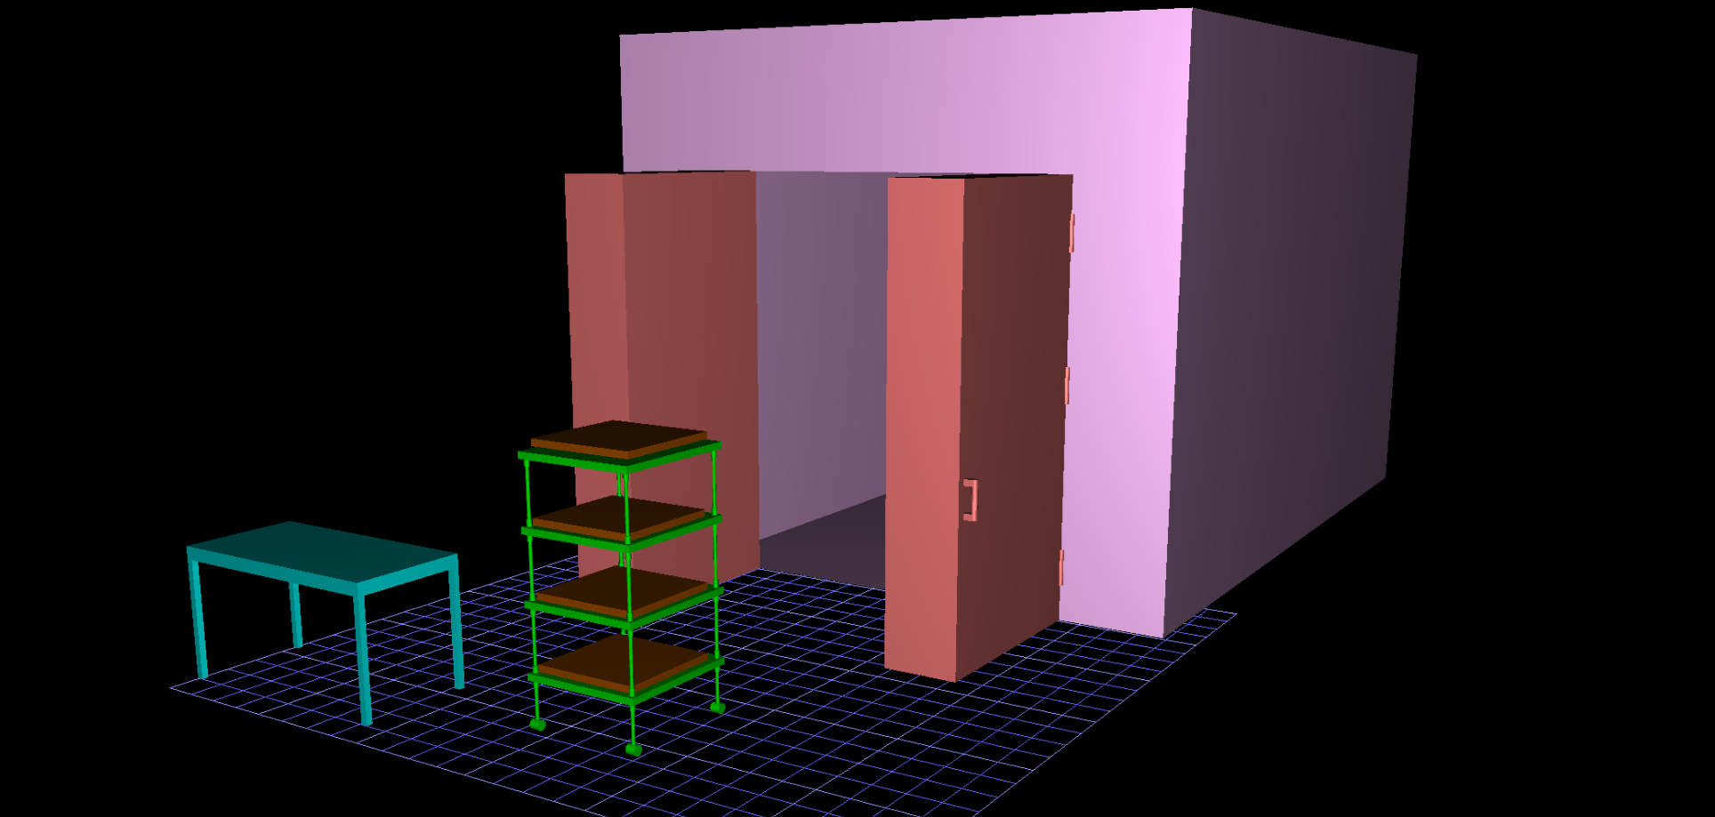
Current Design
Notes:
The current design

Slide 5
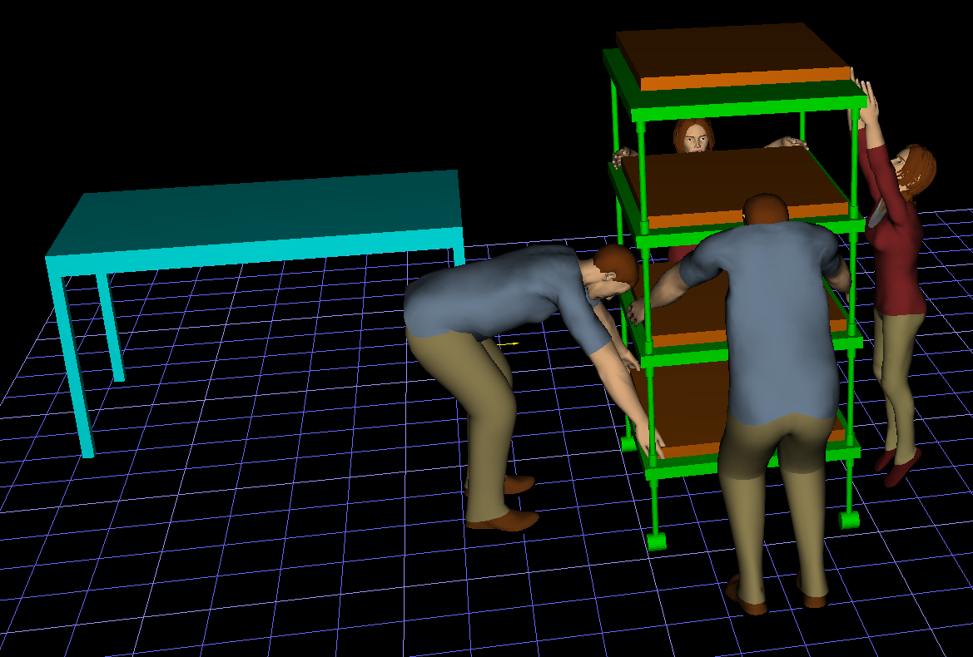
Racks
Figure 1: Current Rack situation
Notes:
The current process requires individuals to reach 16” off the ground to retrieve the board from the lowest rack and 76” off the ground to retrieve boards front he highest rack

Slide 6
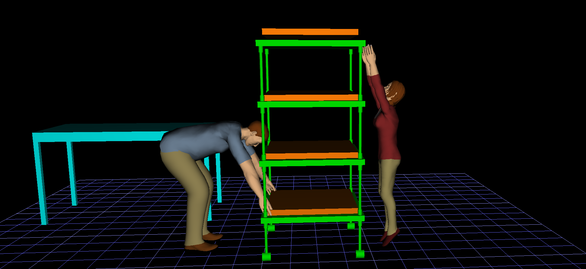
Figure 2: 95th percentile male and 5th percentile female Rack
95th percentile male 5th percentile female
Low rack 16” above the ground High rack 76” above the ground
3965.1 N Compression Force 4% Capable
Notes:
For a 5th percentile female, reaching 76” off the ground to retrieve the board is not feasible as she cannot reach that high. Even if it was placed at a height she can reach, the forces applied to her shoulder would also result in 4% capability for individuals of her stature.
For the 95th percentile male reaching for the 10lb board on the lowest rack at 16” off the ground, the limits on the spinal loading forces are breached with a compression force of nearly 4000N and shear force upwards of 1200N. Furthermore, the racks block the vision for both models when reaching for the board.

Slide 7
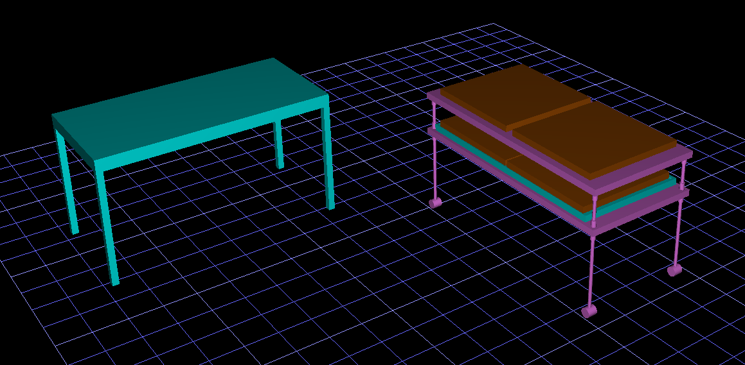
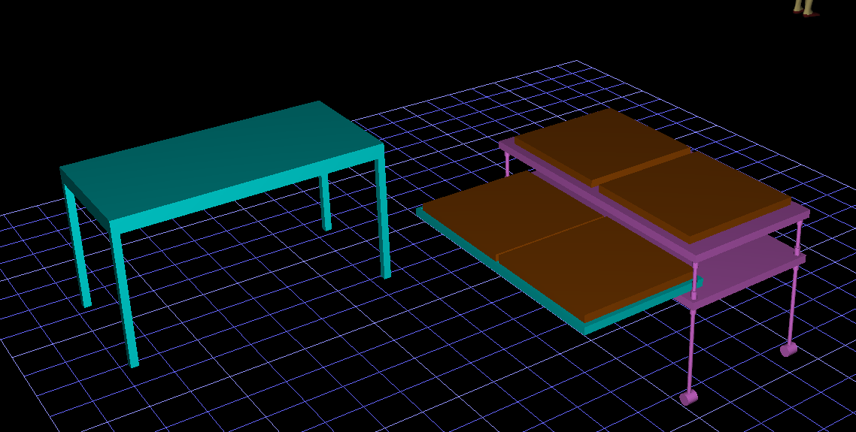
Racks
Figure 3.1: New Rack design
Figure 3.2: New Rack design with slider out
Notes:
The rack redesigns uses the golden rule of ergonomics, “shortest reach and tallest fit”. The two racks are at heights 30” and 40”. 30” is the hand height for the 5th percentile female while 40” is for the 95th percentile male. Furthermore, to address the vision issue, the bottom rack slides out so the workers may have full vision before interacting with the board.

Slide 8
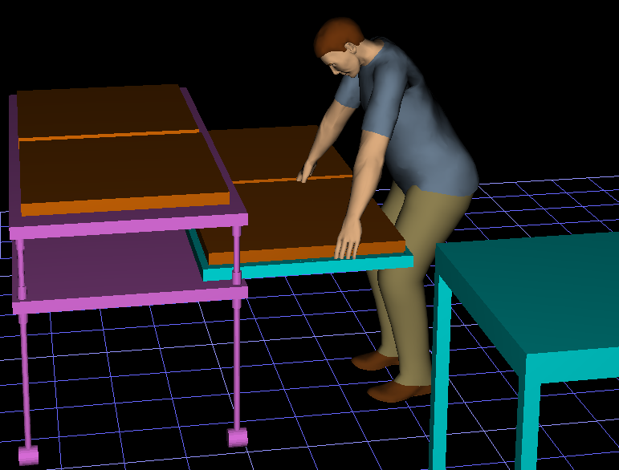
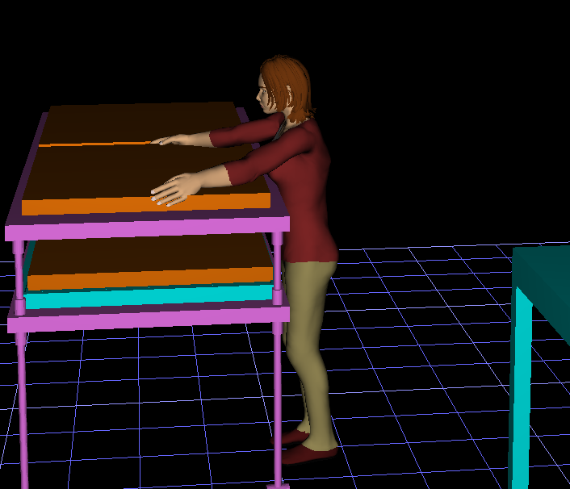
Figure 4.1: 95th percentile male rack redesign
Figure 4.2: 5th percentile female rack redesign
95th percentile male 5th percentile female
Low rack 30” above the ground High rack 40” above the ground
2521.6 N Compression Force 97% Capable
Notes:
The redesign imposes approximately 2500N of compression force and 600N of shear force on the spine for the 95th percentile male which is well within the NIOSH limits. For the female, JACK determined that individuals of her stature are 97% capable.

Slide 9
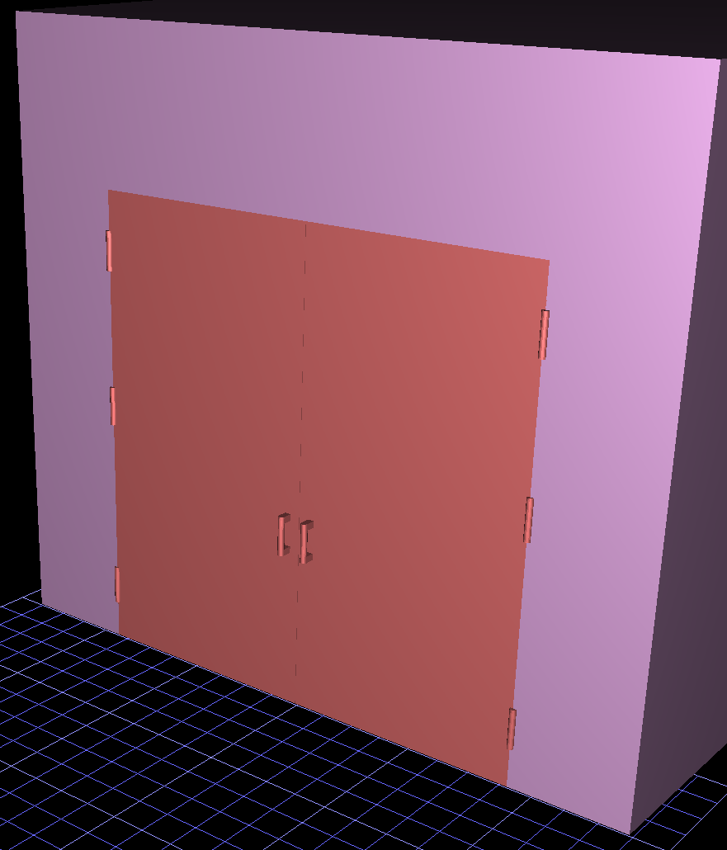
Furnace
Notes:
For this section we’re going to talk about the current furnace design.

Slide 10
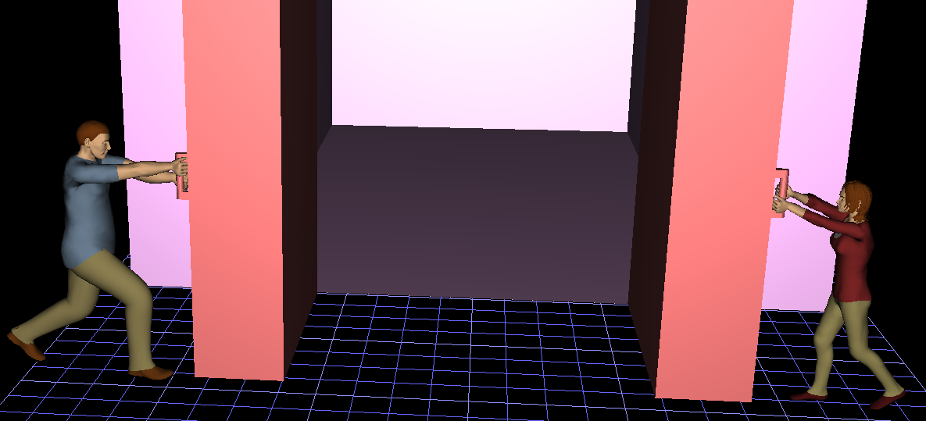
Figure 5: Furnace Opening
Force Analysis
300 kg weight 16ft x 6ft
3 hinges/door Handle located 5ft-9in away from horizontal edge
1176 N force per hinge 683N lateral force
Notes:
The current oven door in use weighs 300 kg and has 3 hinges on each door. Currently, there is a 1176 N force on each of the 3 hinges connected to the doors. This resulted in the worker having to exert a lateral force of 683N to open/close for the push/pull action. It is worth noting that this force may vary depending on lubricant use, friction, air resistance, etc.
As a result of this, new concepts will be investigated to lower the degree of this opening force.

Slide 11
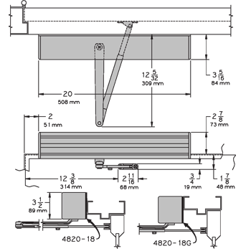

Alternative one
Pneumatic door opening/closing
Mechanism
Capable of supporting up to 250kg weight
$1627.50 x 2 (for 2 doors) = $3255
opening/closing force approx. 245N
Figure 6: LCN 4822 Pneumatic Door Closer / Opener
Notes:
This picture displays the pneumatic door opening/closing model. This model is capable of supporting a door of weight 250kg and costs $1627.50 each from the website. This alternative is an excellent choice for force reduction, but since the door in question weighs 300kg, this alone can not be implemented. Using this would make the opening force 245 N.

Slide 12
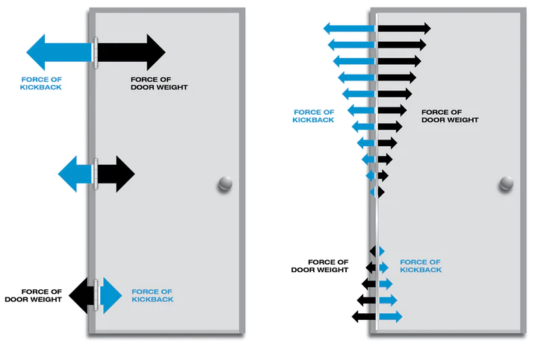
Alternative two
Continuous hinge force distribution
Capable of handling 110.86N/hinge
$115/hinge x 32 hinges (16/door) = $3680
Opening/closing force approx. 300N
Figure 7: Continuous Hinge system
Notes:
This picture displays a continuous hinge system. This mechanism reduces and distributes the force of kickback and weight along vertical edge of the door. This system would subsequently reduce the force/hinge from 1176N/hinge to 183.75N/hinge. This model would reduce the opening force from 683N to approximately 300N, but also cannot be implemented alone since the hinges are not capable of handling a force over 110.86N/hinge independently, and would not pass the test of time.

Slide 13
Alternative Three
Combination of both
Together can handle Weight
Significantly reduce the opening/closing force
Figure 7: Continuous Hinge system
Figure 6: LCN 4822 Pneumatic Door Closer / Opener
Notes:
It is recommended that a combination of both alternatives be implemented. When both are combined, the hinges would be within a tolerable limit of force/hinge, the doors weight would be accounted for, and the worker would have no problem opening/closing the oven door, especially when repetition is taken into account.

Slide 14
Implementation costs
Design | Price
LCN 4822 Pneumatic Door Closer / Opener | $1627.50 x 2 (for 2 doors) = $3255
Ives 224HD Heavy Duty Full Mortise Continuous Gear Hinge | $115/hinge x 32 hinges (16/door) = $3680
Total | $6935
Cons:
Expensive
Pros:
Worker Well-being
Task Time reduction
Injury payout/lawsuits/subsequent cost reduction
Notes:
The subsequent total cost of implementations is $6935, with some pros and cons of implementation shown above.

Slide 15
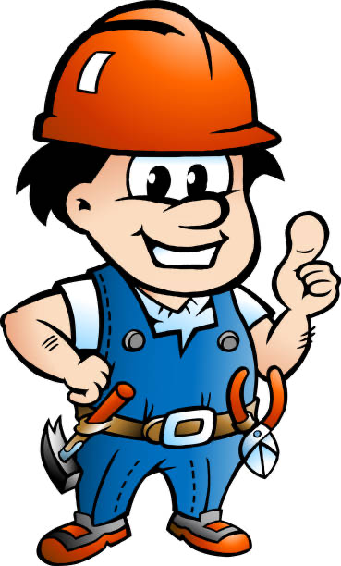
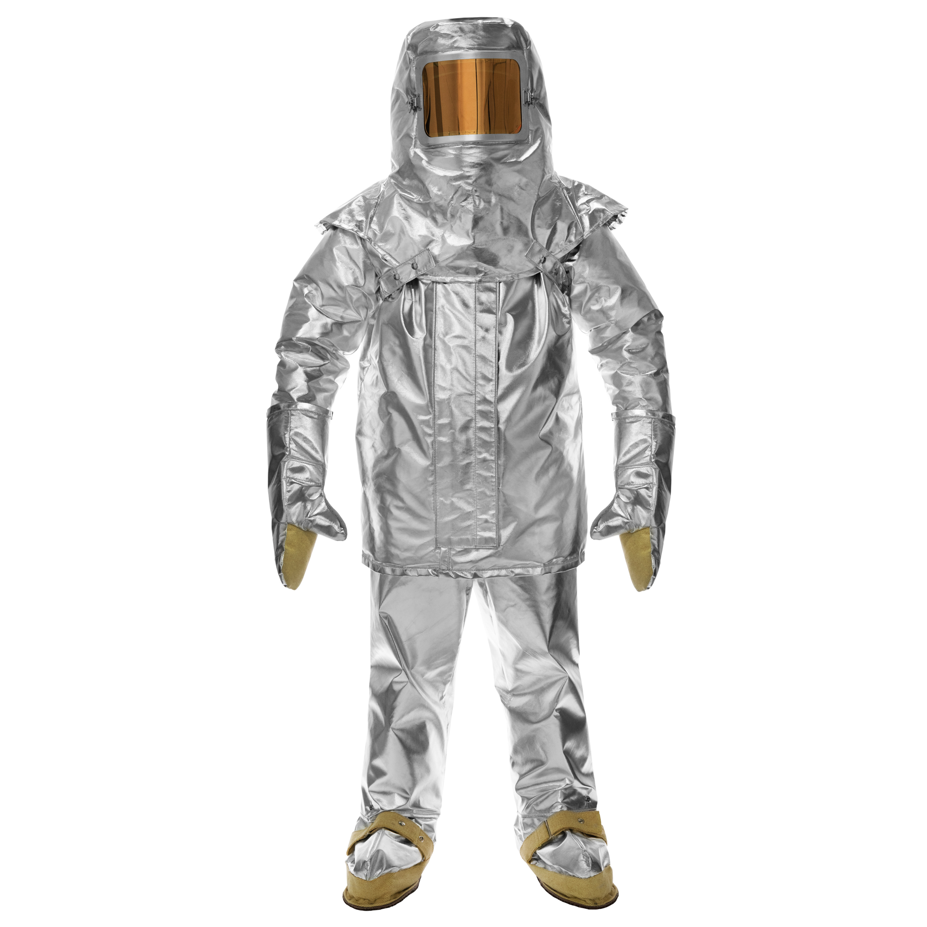
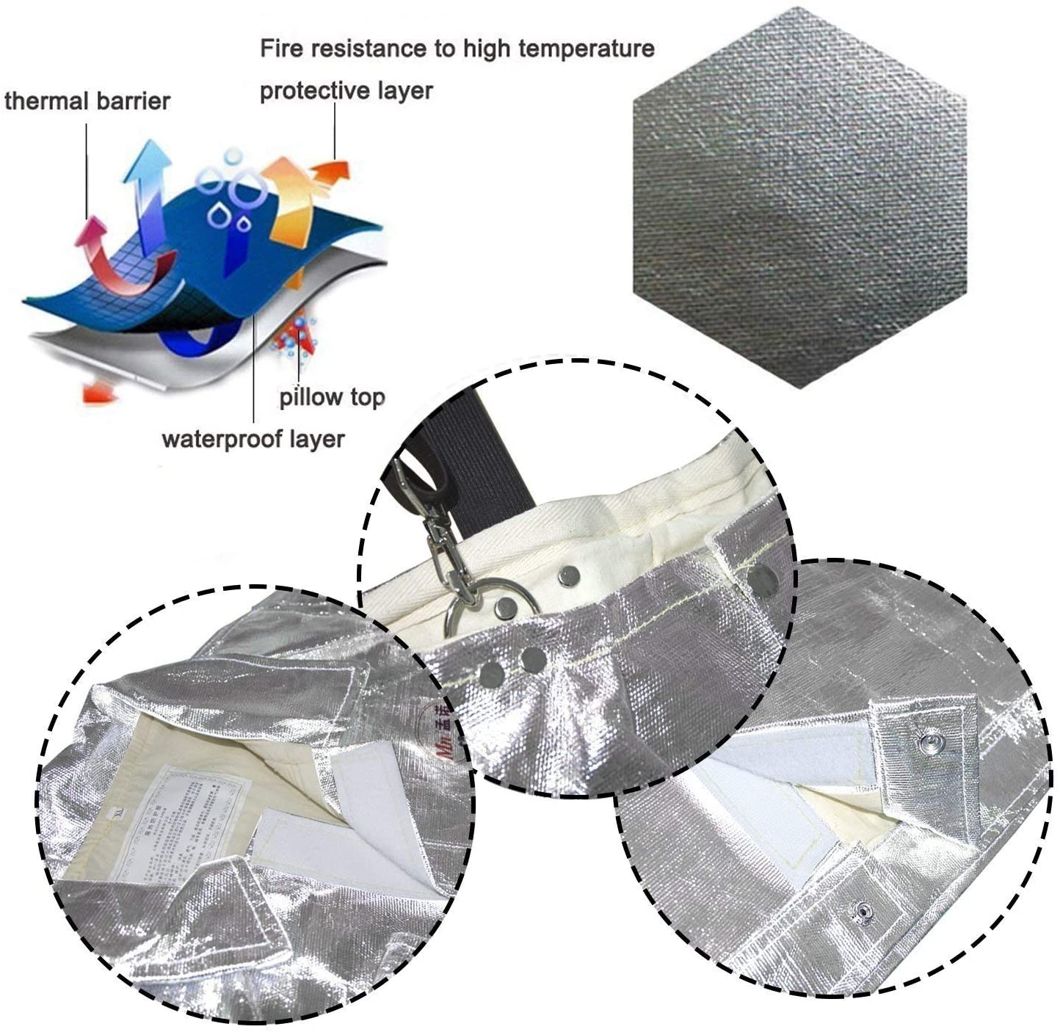
Solution to Psychosocial Effects
Figure 8: Proximity Suit
Figure 9: Proximity Suit Capabilities
Figure 10: Happy Worker
Notes:
As discussed, the workers will be entering and being inside the furnace for 1-5 minutes in repeated intervals.
The physical health impacts could result in low energy levels and On the other hand, the mental health impacts follow emotional pressure and thoughts of negativity in the users life followed by inconsistent sleeping schedules. these effects can lead to an increase in acts of violence, increased irritability, and angry mood swings.
A proposed solution is to introduce a new worker that will be responsible for going into the furnace at all times with a proximity suit as seen on the left. The suit offers protection in high heat areas while also preventing the rapid buildup of body heat. This implementation will ultimately ensure the workers satisfaction in this process as they would not be enduring the mental and physical stress that comes with the heat inside the furnace.

Slide 16

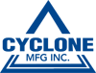
Conclusion
Notes:
To conclude, it was found that applying changes discussed throughout this report, while they may cost the company a small sum, the benefit to the workers and overall operation far outweighs the cost and would help the workplace thrive

Slide 17
References
[8] Keko-Ka, Andrew_Rybalko, Alashi, Images, C., Timoph, Cmapuk_kpynckuu, . . . RUSSELLTATEdotCOM. (n.d.). People who work stock vector Art 470592032. Retrieved April 15, 2021, from https://www.istockphoto.com/illustrations/factory-workers-walking
[9] 700 series PROXIMITY SUIT. (n.d.). Retrieved April 15, 2021, from https://www.lakeland.com/canada/product/aluminized-700ag
[10]Fire resistant Suit, VINMAX thermal RADIATION 1000 degree heat RESISTANT Aluminized Suit Fireproof CLOTHES include 1 Coat+1 Pant+1 Helmet+1 Pair GLOVE+1 Pair Shoe Cover (shipping from us). (n.d.). Retrieved April 15, 2021, from https://www.amazon.ca/Resistant-vinmax-Radiation-Aluminized-Fireproof/dp/B07QKWSY8W

